Slide 1
Probability
Probability for dependent events

Slide 2
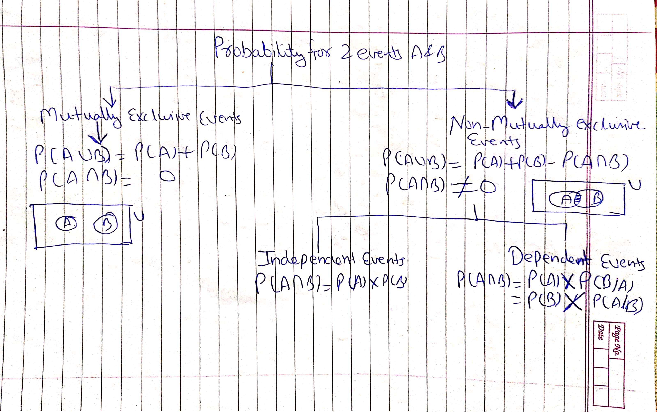
Probability for 2 events A and B

Slide 3
Dependent events
Dependent events- If happening of one event ( say A ) affect the happening of other event(say B), then A & B are dependent events.
If A & B are independent events, P(A∩B) = P(A)×P(B)
If A & B are dependent events, P(A∩B) = P(A) × P(B/A)
=P(B) × p(A/B)
Conditional probability
When A & B are dependent events, then P(A/B) denotes probability of happening of event A when B has already occurred. Similarly, P(B/A) denotes probability of happening of B when A has already occurred.

Slide 4
Type of problems based on dependent events
There are 2 types of problems based on dependent events-
1. Based on random experiments with equal probable outcomes (Toss, Dice and Cards)
2. Based on Random experiments (non equal probable outcomes)

Slide 5
Problems based on random experiments with equal probable outcomes (Toss, Dice and Cards)
Two events are dependent if the outcome of the first event affects the outcome of the second event, so that the probability is changed.
Representation of dependent event-
1. A/B = event A when event B has already occurred
2. B/A = event B when event A has already occurred
Example 1- Random experiment = rolling a die, sample space = (1, 2, 3, 4, 5, 6)
Event A = outcome is multiple of 3
Event B = outcome is even
What is the value of P(A/B) and P(B/A) ?
Example 2- Random experiment = Picking a card, number of possible outcomes = 52
Event A = the card drawn is red
Event B = the card drawn is king,
What is the value of P(A/B) and P(B/A) ?

Slide 6
Problems based on random experiments with equal probable outcomes (Toss, Dice and Cards)
Two events are dependent if the outcome of the first event affects the outcome of the second event, so that the probability is changed.
Representation of dependent event-
1. A/B = event A when event B has already occurred
2. B/A = event B when event A has already occurred
Example 1- Random experiment = rolling a die, sample space = (1, 2, 3, 4, 5, 6)
Event A = outcome is multiple of 3, set of favourable outcomes = (3, 6), P(A) = 2/6 = 1/3
Event B = outcome is even, set of favourable outcomes = (2, 4, 6), P(B) = 3/6 = 1/2
Event A/B = outcome is multiple of 3 if it is known that outcome is an even number
Event B/A = outcome is an even number if it is known that outcome is a multiple of 3
What is the value of P(A/B) and P(B/A) ?
Example 2- Random experiment = Picking a card, number of possible outcomes = 52
Event A = the card drawn is red, number of favourable outcomes = 26, P(A) = 26/52 = 1/2
Event B = the card drawn is king, number of favourable outcomes = 4, P(B) = 4/52 = 1/13
Event A/B = the card drawn is red if it is known that the card drawn is king
Event B/A = the card drawn is a king if it is known that the card drawn is red
What is the value of P(A/B) and P(B/A) ?

Slide 7
Solution
Solution 1- Random experiment = rolling a die, sample space = (1, 2, 3, 4, 5, 6)
Event A = outcome is multiple of 3, set of favourable outcomes = (3, 6), P(A) = 2/6 = 1/3
Event B = outcome is even, set of favourable outcomes = (2, 4, 6), P(B) = 3/6 = 1/2
Event A/B = outcome is multiple of 3 if it is known that outcome is an even number
Event B/A = outcome is an even number if it is known that outcome is a multiple of 3
Event AꓵB = Outcome is even and multiple of 3, set of favourable outcomes = (6), P(AꓵB ) = 1/6
So, P(A/B) = P(AꓵB)/P(B) = (1/6)/(1/2) = 1/3
And P(B/A) = P(AꓵB)/P(A) = (1/6)/(1/3) = 1/2
Solution 2- Random experiment = Picking a card, number of possible outcomes = 52
Event A = the card drawn is red, number of favourable outcomes = 26, P(A) = 26/52 = 1/2
Event B = the card drawn is king, number of favourable outcomes = 4, P(B) = 4/52 = 1/13
Event A/B = the card drawn is red if it is known that the card drawn is king
Event B/A = the card drawn is a king if it is known that the card drawn is red
Event AꓵB = the card drawn is a king of red colour, number of favourable outcomes = 2, P(AꓵB ) = 2/52 = 1/26
So, P(A/B) = P(AꓵB)/P(B) = (1/26)/(1/13) = 13/26 = 1/2
And P(B/A) = P(AꓵB)/P(A) = (1/26)/(1/2) = 2/26 = 1/13

Slide 8
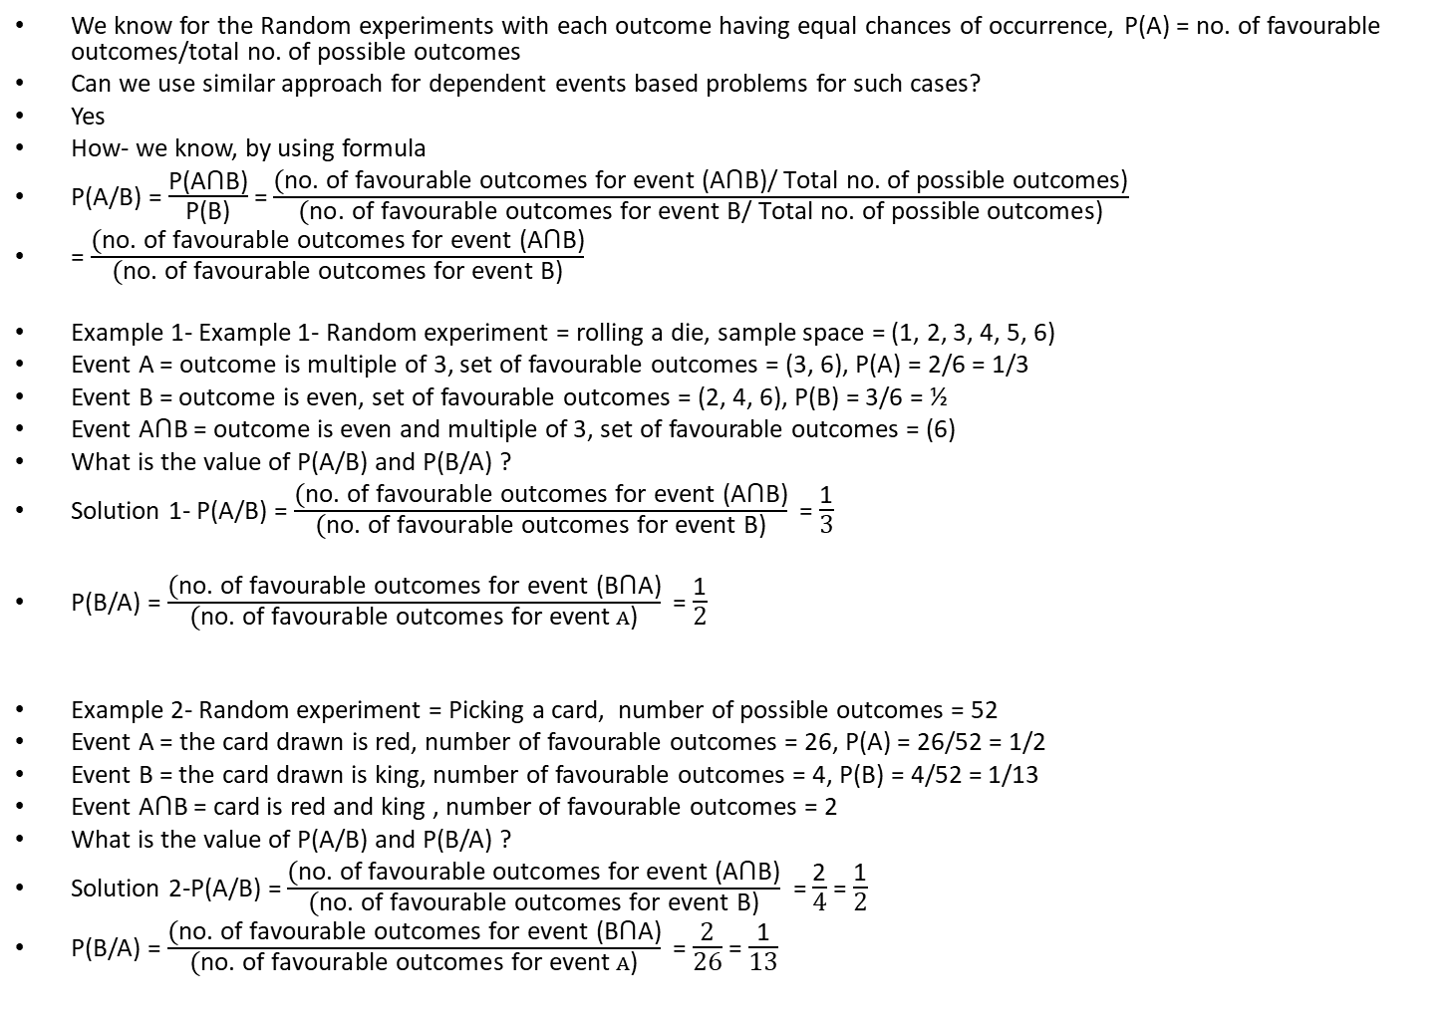
Another approach to solve dependent probability problems based on Toss, Dice or picking a card
We know for the Random experiments with each outcome having equal chances of occurrence, P(A) = no. of favourable outcomes/total no. of possible outcomes
Can we use similar approach for dependent events based problems for such cases?
Yes
How- we know, by using formula
P(A/B) = $\frac{\text{P}\text{(}\text{A}\text{ꓵ}\text{B}\text{)}}{\text{P}\text{(}\text{B}\text{)}}$= $\frac{\text{(}\text{no}\text{. }\text{of} \text{favourable} \text{outcomes} \text{for} \text{event}\text{ (}\text{A}\text{ꓵ}\text{B}\text{)/ }\text{Total} \text{no}\text{. }\text{of} \text{possible} \text{outcomes}\text{)}}{\text{(}\text{no}\text{. }\text{of} \text{favourable} \text{outcomes} \text{for} \text{event} \text{B}\text{/ }\text{Total} \text{no}\text{. }\text{of} \text{possible} \text{outcomes}\text{)}}$
= $\frac{\text{(}\text{no}\text{. }\text{of} \text{favourable} \text{outcomes} \text{for} \text{event}\text{ (}\text{A}\text{ꓵ}\text{B}\text{)}}{\text{(}\text{no}\text{. }\text{of} \text{favourable} \text{outcomes} \text{for} \text{event} \text{B}\text{)}}$
Example 1- Example 1- Random experiment = rolling a die, sample space = (1, 2, 3, 4, 5, 6)
Event A = outcome is multiple of 3, set of favourable outcomes = (3, 6), P(A) = 2/6 = 1/3
Event B = outcome is even, set of favourable outcomes = (2, 4, 6), P(B) = 3/6 = ½
Event $\text{A}\text{ꓵ}\text{B}$ = outcome is even and multiple of 3, set of favourable outcomes = (6)
What is the value of P(A/B) and P(B/A) ?
Solution 1- P(A/B) = $\frac{\text{(}\text{no}\text{. }\text{of} \text{favourable} \text{outcomes} \text{for} \text{event}\text{ (}\text{A}\text{ꓵ}\text{B}\text{)}}{\text{(}\text{no}\text{. }\text{of} \text{favourable} \text{outcomes} \text{for} \text{event} \text{B}\text{)}}$ = $\frac{\text{1}}{\text{3}}$
P(B/A) = $\frac{\text{(}\text{no}\text{. }\text{of} \text{favourable} \text{outcomes} \text{for} \text{event}\text{ (}\text{B}\text{ꓵ}\text{A}\text{)}}{\text{(}\text{no}\text{. }\text{of} \text{favourable} \text{outcomes} \text{for} \text{event} A\text{)}}$ = $\frac{\text{1}}{\text{2}}$
Example 2- Random experiment = Picking a card, number of possible outcomes = 52
Event A = the card drawn is red, number of favourable outcomes = 26, P(A) = 26/52 = 1/2
Event B = the card drawn is king, number of favourable outcomes = 4, P(B) = 4/52 = 1/13
Event $\text{A}\text{ꓵ}\text{B}$ = card is red and king , number of favourable outcomes = 2
What is the value of P(A/B) and P(B/A) ?
Solution 2-P(A/B) = $\frac{\text{(}\text{no}\text{. }\text{of} \text{favourable} \text{outcomes} \text{for} \text{event}\text{ (}\text{A}\text{ꓵ}\text{B}\text{)}}{\text{(}\text{no}\text{. }\text{of} \text{favourable} \text{outcomes} \text{for} \text{event} \text{B}\text{)}}$ = $\frac{\text{2}}{\text{4}}$= $\frac{\text{1}}{\text{2}}$
P(B/A) = $\frac{\text{(}\text{no}\text{. }\text{of} \text{favourable} \text{outcomes} \text{for} \text{event}\text{ (}\text{B}\text{ꓵ}\text{A}\text{)}}{\text{(}\text{no}\text{. }\text{of} \text{favourable} \text{outcomes} \text{for} \text{event} A\text{)}}$ = $\frac{\text{2}}{\text{26}}$= $\frac{\text{1}}{\text{13}}$

Slide 9
2. Problems based on dependent events – Random experiments (non equal probable outcomes)
In such problems, we are given P(A/B) and we need to find P(B/A)
In conditional probability questions (i.e. non-mutually exclusive dependent events), most of the questions are framed in a manner in which P(A/B) is given & P(B/A) is to be calculated. So, we first find P(A∩B) by using P(A/B) in such cases & then use it to find P(B/A).
How to solve these problems??
1. Use Baye’s Theorem
2. Use Tree diagram (easier way)

Slide 10
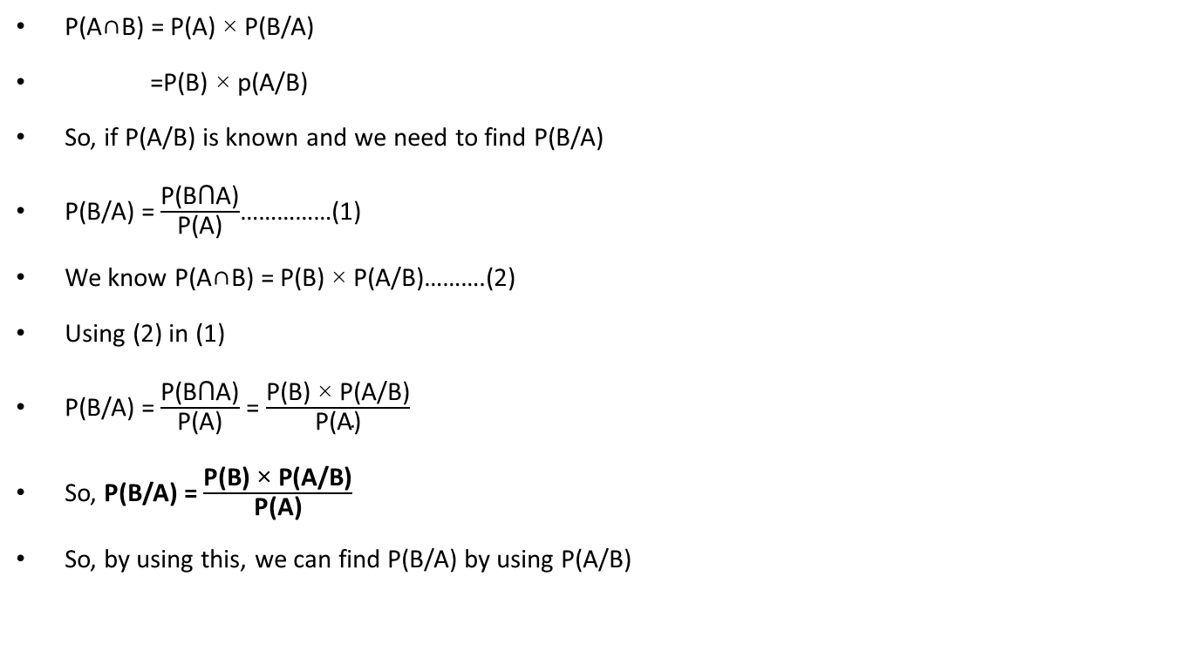
Baye’s Theorems
P(A∩B) = P(A) × P(B/A)
=P(B) × p(A/B)
So, if P(A/B) is known and we need to find P(B/A)
P(B/A) = $\frac{\text{P}\text{(}\text{B}\text{ꓵ}\text{A}\text{)}}{\text{P}\text{(}\text{A}\text{)}}$……………(1)
We know P(A∩B) = P(B) × P(A/B)……….(2)
Using (2) in (1)
P(B/A) = $\frac{\text{P}\text{(}\text{B}\text{ꓵ}\text{A}\text{)}}{\text{P}\text{(}\text{A}\text{)}}$ = $\frac{\text{P}\text{(}\text{B}\text{) × }\text{P}\text{(}\text{A}\text{/}\text{B}\text{)}}{\text{P}\text{(}\text{A}\text{)}}$
So, P(B/A) = $\frac{\text{P}\text{(}\text{B}\text{) × }\text{P}\text{(}\text{A}\text{/}\text{B}\text{)}}{\text{P}\text{(}\text{A}\text{)}}$
So, by using this, we can find P(B/A) by using P(A/B)

Slide 11
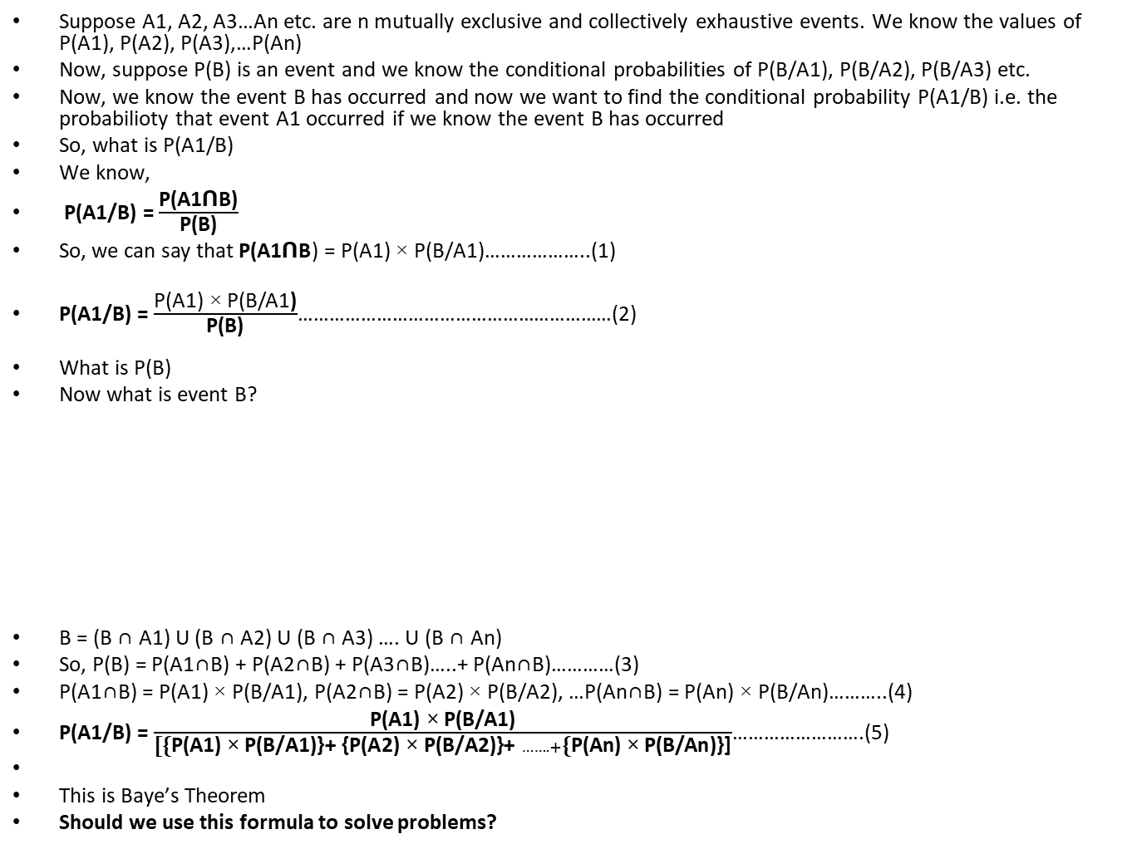
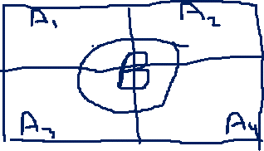
Bayes theorem
Suppose A1, A2, A3…An etc. are n mutually exclusive and collectively exhaustive events. We know the values of P(A1), P(A2), P(A3),…P(An)
Now, suppose P(B) is an event and we know the conditional probabilities of P(B/A1), P(B/A2), P(B/A3) etc.
Now, we know the event B has occurred and now we want to find the conditional probability P(A1/B) i.e. the probabilioty that event A1 occurred if we know the event B has occurred
So, what is P(A1/B)
We know,
P(A1/B) = $\frac{\text{P}\text{(}\text{A}\text{1}\text{ꓵ}\text{B}\text{)}}{\text{P}\text{(}\text{B}\text{)}}$
So, we can say that $\text{P}\text{(}\text{A}\text{1}\text{ꓵ}\text{B}$) = P(A1) × P(B/A1)………………..(1)
P(A1/B) = $\frac{\text{P}\text{(}\text{A}\text{1}\text{) ×} \text{P}\text{(}\text{B}\text{/}\text{A}\text{1}\text{)}}{\text{P}\text{(}\text{B}\text{)}}$……………………………………………………(2)
What is P(B)
Now what is event B?
B = (B ∩ A1) U (B ∩ A2) U (B ∩ A3) …. U (B ∩ An)
So, P(B) = P(A1∩B) + P(A2∩B) + P(A3∩B)…..+ P(An∩B)…………(3)
P(A1∩B) = P(A1) × P(B/A1), P(A2∩B) = P(A2) × P(B/A2), …P(An∩B) = P(An) × P(B/An)………..(4)
P(A1/B) = $\frac{\text{P}\text{(}\text{A}\text{1}\text{) ×} \text{P}\text{(}\text{B}\text{/}\text{A}\text{1}\text{)}}{\text{[\{}\text{P}\text{(}\text{A}\text{1}\text{) ×} \text{P}\text{(}\text{B}\text{/}\text{A}\text{1}\text{)}\text{\}+} \text{\{}\text{P}\text{(}\text{A}\text{2}\text{) ×} \text{P}\text{(}\text{B}\text{/}\text{A}\text{2}\text{)}\text{\}+ }…….+\text{\{}\text{P}\text{(}\text{An}\text{) × }\text{P}\text{(}\text{B}\text{/}\text{An}\text{)}\text{\}]}}$…………………….(5)
This is Baye’s Theorem
Should we use this formula to solve problems?

Slide 12
Example 1: The probability that a student revises for the exam is 0.4. If a student revises, the probability that they pass is 0.7, otherwise it is only 0.1. Given that a student passes the CA3 exam, find the probability that the student revised?
a) 0.824 b)0.4 c) 0.992 d)0.6
Example 2: On a saturday night the probability that a driver has been drinking is 0.2.If the driver has been drinking,the probability that they have an accident is 0.05,otherwise it is 0.0001.At an accident on Saturday night,the police carry out breath test,then the probability that the driver has been drinking is
a) 0.001 b)0.01 c) 0.992 d)0.95
Example 3: The probability that a car accident is due to faulty brakes is 0.02, the probability that a car accident is correctly attributed to faulty brakes is 0.95, and the probability that a caraccident is incorrectly attributed to faulty brakes is 0.01. What is the probability that a car accident, which is attributed to faulty brakes, was due to faulty brakes
A. 0.66 B. 0.55 C. 0.99 D. 0.88
Example 4: In a test, an examinee either guesses or copies or knows the answer to a multiple choice question with four choices. The probability that he makes a guess is (1/3) and the probability that he copies the answer is (1/6). The probability that his answer is correct, given that he copied it, is (1/8). Find the probability that he knew the answer to the question, given that he correctly answered it?
a. 24/29 b. 24/39 c. 17/29 d. 17/39
Example 5: XYZ diagnosis center is famous for cancer diagnosis. 2% of people who went there in last month for diagnosis were actually suffering from cancer. The probability that a patient is correctly informed that he/she is suffering from cancer(last month) is 0.95, and the probability that a patient who was told he/she is suffering from cancer (last month) was actually not suffering from cancer is 0.01.What is the probability that a patient who was told that he/she is suffering from cancer (last month) was actually suffering from cancer?
A. 0.55 B. 0.66 C. 0.77 D. 0.88

Slide 13
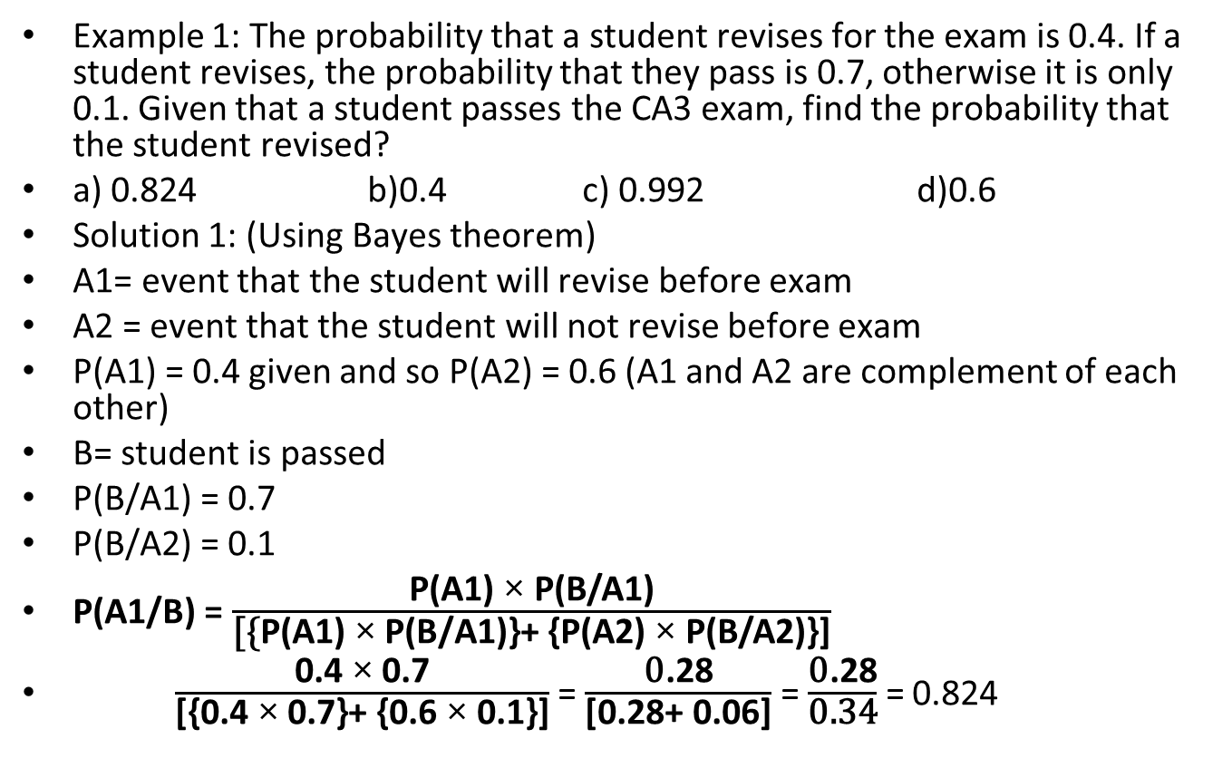
Example 1: The probability that a student revises for the exam is 0.4. If a student revises, the probability that they pass is 0.7, otherwise it is only 0.1. Given that a student passes the CA3 exam, find the probability that the student revised?
a) 0.824 b)0.4 c) 0.992 d)0.6
Solution 1: (Using Bayes theorem)
A1= event that the student will revise before exam
A2 = event that the student will not revise before exam
P(A1) = 0.4 given and so P(A2) = 0.6 (A1 and A2 are complement of each other)
B= student is passed
P(B/A1) = 0.7
P(B/A2) = 0.1
P(A1/B) = $\frac{\text{P}\text{(}\text{A}\text{1}\text{) ×} \text{P}\text{(}\text{B}\text{/}\text{A}\text{1}\text{)}}{\text{[\{}\text{P}\text{(}\text{A}\text{1}\text{) ×} \text{P}\text{(}\text{B}\text{/}\text{A}\text{1}\text{)}\text{\}+} \text{\{}\text{P}\text{(}\text{A}\text{2}\text{) ×} \text{P}\text{(}\text{B}\text{/}\text{A}\text{2}\text{)}\text{\}]}}$
$\frac{\text{0.4} \text{× }\text{0.}\text{7}}{\text{[\{}\text{0.}\text{4} \text{× }\text{0.7}\text{\}+} \text{\{}\text{0.}\text{6} \text{× }\text{0.1}\text{\}]}}$ = $\frac{\text{0}\text{.}\text{28}}{\text{[}\text{0.28}\text{+} \text{0}\text{.0}\text{6}\text{]}}$ = $\frac{\text{0}\text{.28}}{\text{0.34}}$ = 0.824

Slide 14
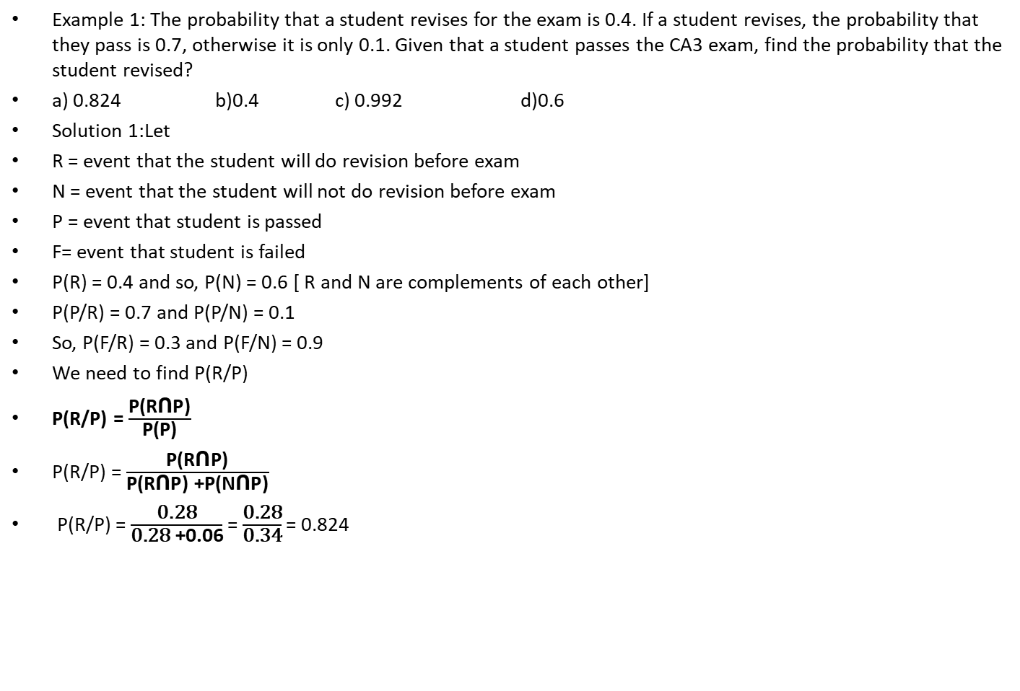
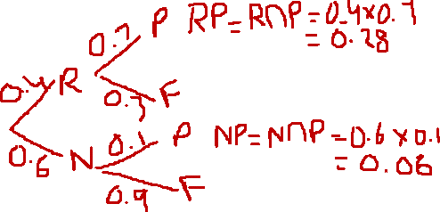
Example 1: The probability that a student revises for the exam is 0.4. If a student revises, the probability that they pass is 0.7, otherwise it is only 0.1. Given that a student passes the CA3 exam, find the probability that the student revised?
a) 0.824 b)0.4 c) 0.992 d)0.6
Solution 1:Let
R = event that the student will do revision before exam
N = event that the student will not do revision before exam
P = event that student is passed
F= event that student is failed
P(R) = 0.4 and so, P(N) = 0.6 [ R and N are complements of each other]
P(P/R) = 0.7 and P(P/N) = 0.1
So, P(F/R) = 0.3 and P(F/N) = 0.9
We need to find P(R/P)
P(R/P) = $\frac{\text{P}\text{(}\text{R}\text{ꓵ}\text{P}\text{)}}{\text{P}\text{(}\text{P}\text{)}}$
P(R/P) = $\frac{\text{P}\text{(}\text{R}\text{ꓵ}\text{P}\text{)}}{\text{P}\text{(}\text{R}\text{ꓵ}\text{P}\text{) +}\text{P}\text{(}\text{N}\text{ꓵ}\text{P}\text{)}}$
P(R/P) = $\frac{\text{0.28}}{\text{0.28} \text{+}\text{0.06}}$ = $\frac{\text{0.28}}{\text{0.34}}$ = 0.824

Slide 15
Example 4: In a test, an examinee either guesses or copies or knows the answer to a multiple choice question with four choices. The probability that he makes a guess is (1/3) and the probability that he copies the answer is (1/6). The probability that his answer is correct, given that he copied it, is (1/8). Find the probability that he knew the answer to the question, given that he correctly answered it?
a. 24/29 b. 24/39 c. 17/29 d. 17/39
Solution 4:
Let A1 , A2 , A3 and B be the events defined as follows :
A1 = the examinee guesses the answer
A2= the examinee copies the answer
A3= the examinee knows the answer and
B= the examinee answers correctly
We have P(A1) = 1/3, P(A2) = 1/6
Since A1 , A2 and A3 are mutually exclusive and exhaustive events therefore
P(A1) + P(A2) + P(A3) = 1
P(A3) = ½
If A1 has already occurred, then the examinee guesses. Since there are four choices out of which only one is correct, therefore the probability that he answers correctly given that he has made a guess is ¼ i.e, P(B / A1 ) = ¼
It is a given that P(B/A2) = 1/8 and P(B/A3 ) is the probability that he answers correctly given that he knew the answer = 1
By Baye’s rule,
Required probability = P(A3/B)
= [P(A3)P(B/A3)] / [P(A1)P(B/A1) + P(A2)P(B/A2) + P(A3)P(B/A3)]
= [ ½ x 1] [ (1/3 x ¼) + (1/6) x (1/8) + (1/2) x 1
= 24/29

Slide 16
Example 4: In a test, an examinee either guesses or copies or knows the answer to a multiple choice question with four choices. The probability that he makes a guess is (1/3) and the probability that he copies the answer is (1/6). The probability that his answer is correct, given that he copied it, is (1/8). Find the probability that he knew the answer to the question, given that he correctly answered it?
a. 24/29 b. 24/39 c. 17/29 d. 17/39
Solution 4:
Let G , C , K and B be the events defined as follows :
G = the examinee guesses the answer
C= the examinee copies the answer
K= the examinee knows the answer and
A= the examinee answers correctly

Slide 17
Example 2: On a saturday night the probability that a driver has been drinking is 0.2.If the driver has been drinking, the probability that they have an accident is 0.05,otherwise it is 0.0001.At an accident on Saturday night, the police carry out breath test,then the probability that the driver has been drinking is
a) 0.001 b)0.01 c) 0.992 d)0.95
Solution 2: By tree diagram only:-

Slide 18
29. What is the probability of forming words by using the letters of word INDIA with vowels being together if we are making all the possible words by using same letters as in given word?
(a) 1/10 (b)2/10 (c) 3/10 (d) none of these

Slide 19
Directions for question number 1-4∶Two fair coins are tossed simultaneously .
Find the probability of
Q1.Getting only one head.
(A) 1/(2 ) (B) 1/(3 ) (C) 2/(3 ) (D) 3/(4 )
Q2.Getting at least one head.
(A) 1/(4 ) (B) 3/(4 ) (C) 1/(2 ) (D) 3/8
Q3.Getting two heads.
(A) 2/(7 ) (B) (1 )/( 4 ) (C) 1/2 (D) 4/5
Q4.Getting at least two heads.
(A) 3/(4 ) (B) 1/(2 ) (C) 1/(4 ) (D)1
Directions for question number 5-11:
Three fair cions are tossed simultaneously.Find the probability of
Q5.Getting one head.
(A) 0 (B) 3/(4 ) (C) 5/(8 ) (D) 3/8
Q6.Getting one tail
(A) 1 (B) 1/(4 ) (C) 5/(8 ) (D) 3/(8 )
Q7.Getting atleast one head
(A) 7/8 (B) 1/8 (C) 3/4 (D) 1/(4 )
Q8.Getting two heads.
(A) 3/(5 ) (B) 3/(8 ) (C) 5/(8 ) (D) 2/5
Q9.Getting atleast two heads.
(A) 3/(8 ) (B) 7/(8 ) (C) 1/(2 ) (D) 1/4
Q10.Getting atleast one head and one tail.
(A) 2/(8 ) (B) 1/(2 ) (C) 3/(10 ) (D)3/4
Q11.Getting more heads than the number of tails.
(A) 2/(5 ) (B) 7/(8 ) (C) 5/(8 ) (D) 1/2

Slide 20
Directions for question number 12-20∶
Two dice are rolled simultaneously.Find the probability of
Q12.Getting a total of 9
(A) 1/(3 ) (B) 1/(9 ) (C) 8/(9 ) (D) 9/10
Q13.Getting a sum greater than 9
(A) 10/(11 ) (B) 5/(6 ) (C) 1/(6 ) (D) 8/9
Q14.Getting a total of 9 or 11
(A) 2/(99 ) (B) 20/(99 ) (C) 1/6 (D) 1/(10 )
Q15.Getting a doublet.
(A) 1/(12 ) (B) 0 (C) 5/(8 ) (D) 1/6
Q16.Getting a doublet of even numbers.
(A) 5/(8 ) (B) 1/(12 ) (C) 3/(4 ) (D) 1/(4 )
Q17.Getting a multiple of 2 on one die and a multiple of 3 on the other.
(A) 15/(36 ) (B) 25/(36 ) (C) 11/(36 ) (D) 5/(6 )
Q18.Getting the sum of numbers on the two faces divisible by 3 or 4.
(A) 4/(9 ) (B) 1/(7 ) (C) 5/(9 ) (D) 7/(12 )
Q19.Getting the sum as a prime number
(A) 3/(5 ) (B) 5/(12 ) (C) 1/2 (D) 3/4
Q20.Getting at least one '5'
(A) 3/(5 ) (B) 1/(5 ) (C) 5/(36 ) (D) 11/36

Slide 21
Directions for questions number 21-28∶one card is drawn from a pack of 52 cards.
Each of the 52 card being equally likely to be drawn.Find the probability thatQ21.The card drawn is black.
(A) 1/(2 ) (B) 1/(4 ) (C) 8/(13 ) (D)can^' tbe determine
Q22.The card drawn is a queen.
(A) 1/(12 ) (B) 1/(13 ) (C) 1/(4 ) (D) 3/4
Q23.The card drawn is black and a queen.
(A) 1/(13 ) (B) 1/(52 ) (C) 1/(26 ) (D) 5/6
Q24.The card drawn is either black or a queen.
(A) 15/(26 ) (B) 13/17 (C) 7/(13 ) (D) 15/26
Q25.The card drawn is either king or a queen .
(A) 5/(26 ) (B) 1/(13 ) (C) 2/(13 ) (D) 12/13
Q26.The card drawn is either a heart,a queen or a king.
(A) 17/(52 ) (B) 21/(52 ) (C) 19/(52 ) (D) 9/26
Q27.The card drawn is neither a spade nor a king.
(A) 0 (B) 9/(13 ) (C) 1/(2 ) (D) 4/13
Q28 .The card drawn is neither an ace nor a king.
(A) 11/13 (B) 1/(2 ) (C) 2/(13 ) (D) 11/26
Q29. The odds in favour of an event are 2∶7.Find the probability of occurrence of this event.
(A) 2/(9 ) (B) 5/(12 ) (C) 7/(12 ) (D) 2/5
Q30.The odds against of an event are 5∶7.Find the probability of occurrence of this event.
(A) 3/(8 ) (B) 7/(12 ) (C) 2/(7 ) (D) 5/12

Slide 22
Q31.A box contains 5 defective and 15 non-defective bulbs Two bulbs are chosen at random .Find the probability that both the bulbs are non-defective.(A) 5/(19 ) (B) 3/(20 ) (C) 21/(38 ) (D)None of these
Q32.If A and B be two events in a sample space such that P(A)=3/(10 ) and P(B)=1/(5 ) and P(A∩B)=1/5
Find P(A∪B)
(A) 1/(5 ) (B) 2/(5 ) (C) 3/(5 ) (D) 4/5
Q33.If A and B be two events in a sample space such that P(A)=2/(5 ),P(B)=1/(2 ) and P(A∪B)=3/(5.)
Find P(A∩B).
(A) 3/(10 ) (B) 7/(10 ) (C) ( 4)/(7 ) (D) 4/( 15)
Drections for question number 34-39:
If A and B two mutually exclusive events in a sample space
such that.P(A)=2/(5 ) and P(B)=1/(2 ),then
Q34.Find P(A ̅)
(A) 2/(5 ) (B) 3/(5 ) (C) 4/(5 ) (D) 6/7
Q35.Find P((B ) ̅)
(A) 1/(4 ) (B) 3/(4 ) (C) 1/(2 ) (D) 4/5
Q36.Find P(A∪B)
(A) 7/(16 ) (B) 9/(16 ) (C) 9/(10 ) (D) 1/2
Q37.Find P((A ) ̅∩(B ) ̅)
(A) 4/(5 ) (B) 1/(10 ) (C) 8/(9 ) (D) 13/20
Q38.Find P((A ) ̅∩B)
(A) 1/(2 ) (B) 3/(5 ) (C) 4/(7 ) (D) 7/15
Q39.Find P(A∩(B ) ̅)
(A) 1/(5 ) (B) 2/(5 ) (C) 4/(15 ) (D) 3/10
Q40.If P((A ) ̅ )=0.65,P(A∪B)0.65,where A and B are two mutually exclusive events then findP(B).
(A)0.60 (B) 0.30 (C) 0.70 (D)None of these

Slide 23
Q41.A natural number is chosen at random from the first 100 natural numbers.what is the probability that the number chosen is a mutiple of 2 or 3 or 5.
(A) 30/(100 ) (B) 1/(33 ) (C) 74/(100 ) (D) 7/10
Q42.In a class 40% of the students offered physics,20% offered chemistry and 5% offerd both. If a student is selected at random,find the probability that he has offered physics or chemistry only.
(A)45% (B)55% (C)36% (D)None of theses
Q43.The probabilty that an MBA aspirant will join IIM is 2/(5 ) and that he will jion XLRI is 1/(3 ). Find the prabability that he will join IIM or XLRI.
(A) 4/(15 ) (B) 7/(15 ) (C) 11/(15 ) (D) 8/15
Q44.In a given race,the odds in favour of horses H1,H2 ),H3, and H4 are 1∶2,1∶3,1∶4,1∶5 repectively. Find the probability that one of them wins the race.
(A) 57/(60 ) (B) 1/(20 ) (C) 2/(7 ) (D) 7/60
Direction for question number 45-49∶Two dice are thrown.
The events A,B,C,D ,E and F are described as follows.
A=Getting an even number on the first die., B=Getting an odd number on the first die., C=Getting at most 5 as sum of the numbers on the two dice., D=Getting the sum of the numbers on the dice greater than 5 but less than 10, E=Getting at least 10 as the sum of the numbers on the dice, F=Getting an odd number on one of the dice.
Q45.Which of the following is correct?
(A) A and B are not mutually exclusive events. (B) A and B are mutually exclusive events. (C) A=B (D)None of these
Q46.Which of the following is correct ?
(A) A and B are exhaustive events but not mutually exclsive events. (B) A and B are not exhaustive events but mutually exclusive events.
(C) A and B are exhaustive events as well as mutually exclsive events. (D) None of these
Q47.Which of the following is not correct ?
(A) A≠C (B) A and C are mutually exclusive events (C) A∩B=∅ (D) None of these
Q48.Which of the following is correct ?
(A) A^' and B^' are not mutually exclusive events. (B) A 'and B^' are mutually exclsive events. (C) A^'∩B^’=∅ (D)None of these
Q49.Which of the following is correct?
(A) A,B,F are mutually exclusive and exhaustive events (B) Aand B are not mutually exclusive events.
(C)B and C are not mutually exclusive events. (D)None of thsese.

Slide 24
Q50.Which of the following is not correct?
(A) 0≤P(A)≤1 (B) probability of impossible events is 0
(C) probability of sure event is 1 (D)None of these.
Q51.If Aand B are independent events,then which of the following is not correct ?
(A) (A ) ̅and B are independent events. (B) A and (B ) ̅ are independent events.
(C) (A ) ̅and (B ) ̅are independent events (D)None of these
Q52.If A and B are two events such that P(A)=0.5,P(B)=0.6 and P(A∪B)=0.8.Find P(A/(B ))
(A) 1/(3 ) (B) 1/(2 ) (C) 1/(4 ) (D)None of these
Q53.If Aand B are two events such that P(A)=0.4,P(B)=0.8 and P(B/(A ))=0.6.find P(A∪B)
(A) 0.24 (B)0.96 (C)0.04 (D)None of these
Q54.Three fair coins are tossed.Find the probability that they are all tails,if one of the coins shows a tail.
(A) 2/(7 ) (B) 5/(14 ) (C) 1/(7 ) (D)None of these.
Q55.A coin is tossed twice and the four possible out comes are assumed to be equally likely.
If E is the event,"Both head and tail have appeared and F be the event,at most one tail is observed,
find P(E/(F ))and P(F/(E ))
(A) 2/(3 ),1 (B) 1/(3 ),2/(3 ) (C)1,2/(3 ) (D)None of theses
Q56.A die is rolled.If the out come is an odd number,what is the probability that it is a prime number?
(A) 3/(8 ) (B) 7/(9 ) (C) 2/(3 ) (D)None of these

Slide 25
Q57.A die is thrown twice and the sum of the numbers appearing is observed to be 9.
what is the conditional probability that the number 4 has appeared atleast once ?
(A) 1/(2 ) (B) 2/(3 ) (C) 3/(4 ) (D)None of these
Q58.Two dice are thrown.Find the probability that the sum is 8 or greater than 8,
if 4 appears on the first die.
(A) 3/(8 ) (B) 5/(8 ) (C) 1/(2 ) (D) None of these
Q59.A die is rolled.If the out come is an odd number,what is the probability that it is a number greater than1?
(A) 2/(3 ) (B) 1/(3 ) (C) 3/(8 ) (D) 5/6
Q60.In a class 45% students read English,30% read French and 20% read both English and French.
One student is selected at random.Find the probability that he reads English,if it is known that
he reads French
(A) 1/(3 ) (B) 2/(3 ) (C) 5/(6 ) (D)None of these
Q61.In question number 60,find the probability that he reads French if it is known that he reads English.
(A) 4/(9 ) (B) 5/(9 ) (C) 2/(9 ) (D) 1/9
Q62.A couple has two children.Find the probabilty that both are boys,if is known that one of the
children is a boy.
(A) 1/(9 ) (B) 1/(3 ) (C) 2/(3 ) (D) 4/5
Q63.In question number 62,find the probabilty that both are boys,if it is known that the older child is a boy.
(A) 3/(8 ) (B) 1/(2 ) (C) 5/(8 ) (D) 3/4

Slide 26
Directions for question number 64-67∶
A bog contains 3 red and 4 black balls and another bag has 4 red and 2 black balls.One bag is selected at random and from the selected bag a ball is drawn. Let E be the event that the first bag is selected, F be the event that the secand bag is selected,G be the event that ball drawn is red.
Q64.Find P(E)
(A) 1/(2 ) (B) 3/(4 ) (C) 1/(4 ) (D) 5/8
Q65.Find P(F)
(A) 3/(4 ) (B) 1/(2 ) (C) 1/(4 ) (D) 1/6
Q66.Find P (G/(E ))
(A) 5/(6 ) (B) 5/(14 ) (C) 3/(7 ) (D)None of these
Q67.Find P (G/(F ))
(A) 2/(3 ) (B) 1/(9 ) (C) 5/(9 ) (D) 4/5
Q68.A die is rolled twice and the sum of the numbers appearing on them is observed to be 7. What is the conditional probability that the number 2 has appeared at least once ?
(A) 1/(3 ) (B) 1/(4 ) (C) 2/(3 ) (D) 3/4
Q69.A black and a red die are rolled.Find the conditional probability of obtaining a sum greater than 9,given that the black die resulted in a 5.
(A) 1/(2 ) (B) 2/(3 ) (C) 1/(3 ) (D)None of these
Q70.A black and a red die are rolled.Find the conditional probability of obtaining the sum 8,given that the red die resultted in a number less than 4.
(A) 1/(7 ) (B) 1/(8 ) (C) 1/(9 ) (D) 1/10
Q71.A couple has two children.Find the probabilty that both are boys,if it is known that one of the children is a boy.
(A) 1/(2 ) (B) 1/(3 ) (C) 1/(4 ) (D)None of these
Solutions1,A 2,B 3,B 4,C 5,D 6,D 7,A 8,B 9,C 10,D 11,D 12,B 13,C 14,C 15,D 16,B 17,C 18,C 19,B
20,D 21,A 22,B 23,C 24,C 25,C 26,C 27,B 28,A 29,A 30,B 31,C 32,C 33,A 34,B 35,C 36,C
37,B 38,A 39B 40,B 41,C 42,B 43,C 44,A 45,B 46,C 47,B 48,B 49,D 50,D 51,D 52,B 53,B
54,C 55,A 56,C 57,A 58,C 59,A 60,B 61,A 62,B 63,B 64,A 65,B 66,C 67,A 68,A 69,C 70,C 71,B

